Slide 1
通过ScienceDirect建立高效的文献阅读习惯
Name：
励德爱思唯尔信息技术（北京）有限公司
Reed Elsevier Information Technology (Beijing) Co., Ltd
2017 Oct.

Slide 2
The Value of
ScienceDirect
  Elsevier的历史及传承
  科学研究流程
  ScienceDirect全文数据库
  SD上线新功能
  提升可见性

Slide 3
The Value of
ScienceDirect
  Elsevier的历史及传承
  科学研究流程
  ScienceDirect全文数据库
  SD上线新功能
  提升可见性

Slide 4
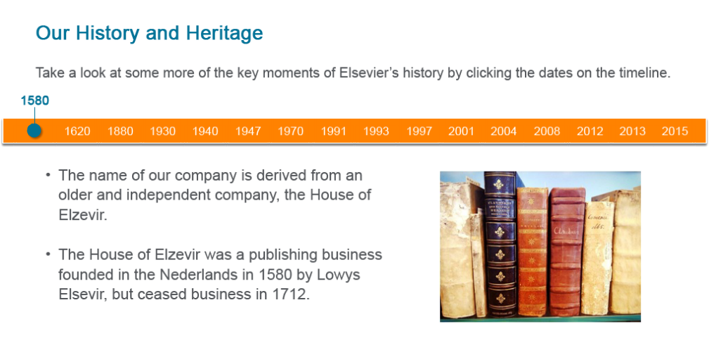

Elsevier的历史与传承
Elsevier的名字来自于一家古老而独立的出版机构
Elzavir出版机构始建于1580年荷兰，但于1712年曾中止过一次服务。

Slide 5
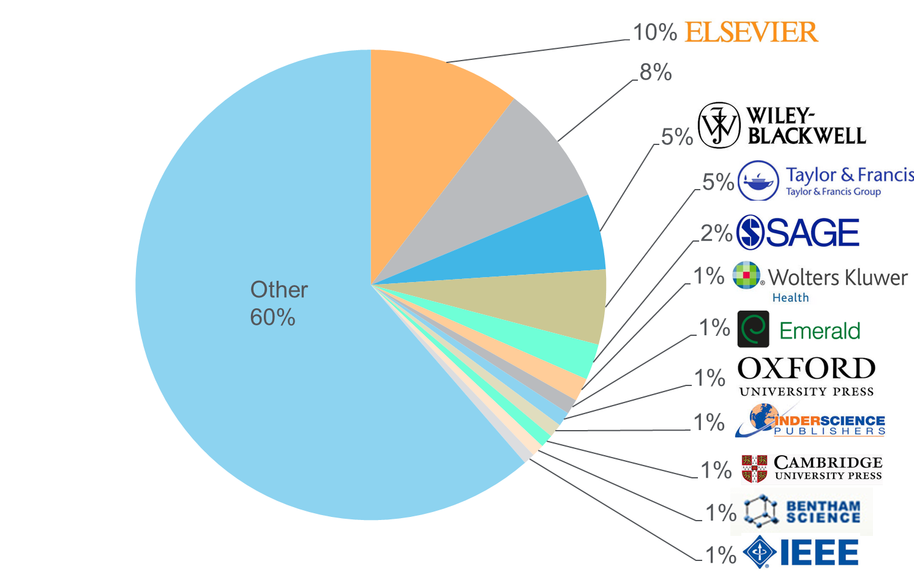

Unbiased, comprehensive journal coverage with titles from many reputable scholarly publishers
Source: November 2015 title list at https://www.elsevier.com/solutions/scopus/content
Notes:
Publisher neutral

Slide 6
动态增长的高质量期刊内容
Content Growth and Content Quality of FC by subject area
Business, Management and Accounting
Decision Sciences
Social Sciences
Environmental Science
Computer Science
Economics, Econometrics and Finance
Engineering
Energy
Pharma
Agricultural and Biological Sciences
Immunology and Microbiology
Veterinary
Arts and Humanities
Chemical Engineering
FWCI 2014
Chemistry
Dentistry
Mathematics
Psychology
Nursing
Earth and Planetary Sciences
Health Professions
Neuroscience
Medicine
Materials Science
Physics and Astronomy
Biochemistry, Genetics and Molecular Biology
5 Year CAGR
FC historic growth per subject area: FC study 2016 (Steffi Oeben)
FWCI is for current FC2016 collection: STMJ Quality tiers analysis Andrew Plume 18 Dec 2015 cut
Notes:
FWCI
CITESCORE
IF

Slide 7
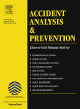
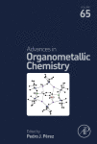
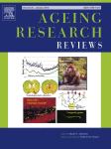
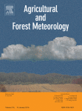
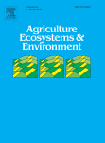
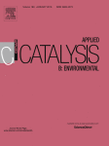
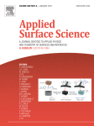
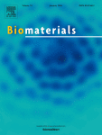
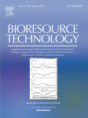
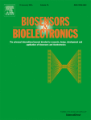
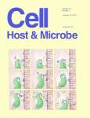
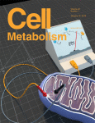
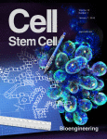
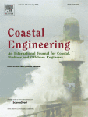
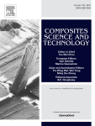
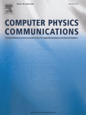
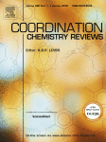
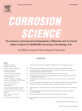
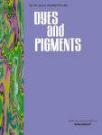
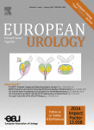


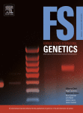
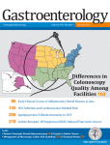
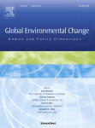
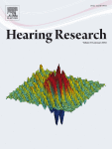
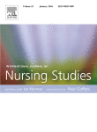
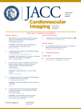
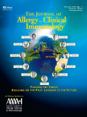
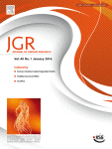
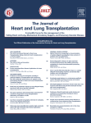
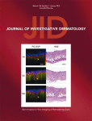
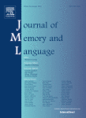

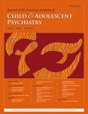
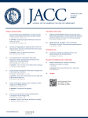
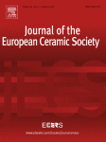
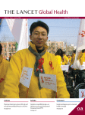
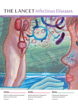
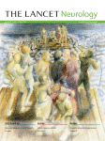
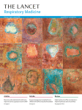
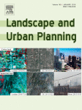
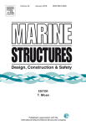
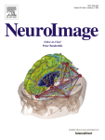
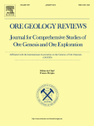
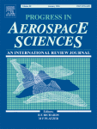
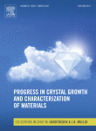
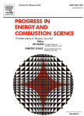
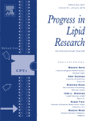
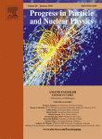
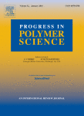











爱思唯尔拥有世界最好的期刊
2015: No.1 in 71 categories out of 235 *
2014: No.1 in 62 categories out of 232
* Includes one book series Advances in Organometallic Chemistry
Source: Thomson Reuters Journal Citation Reports 2015
Notes:
ScienceDirect* journals that rank No.1 in their subject category (2015)

Slide 8
爱思唯尔拥有最具影响力的作者
Publisher | Authors | Average Author FWCI
Elsevier | 2,719,232 | 1.506
Publisher A | 1,716,325 | 1.489
Publisher B | 1,034,646 | 1.453
Publisher | Authors | Average Author H-Index
Elsevier | 2,719,232 | 15.609
Publisher A | 1,716,325 | 13.078
Publisher B | 1,034,646 | 13.228
Notes:
Elsevier plays a crucial role in Quality Control within the global research landscape – and Elsevier uses its 130 years of experience in publishing to find and work with the best quality authors. Elsevier’s quality can be measured against its peers, using metrics such as average author Field Weighted Citation Impact (FWCI) and H-Index. The average FWCI and H-Index analysis shown above was done using publication data from between 2010 and 2014: we filtered for authors that have published at least 4 papers over this time period, and counted any author’s papers published with a publisher (so long as the author had at least 25% of their publications with that publisher between 2010 and 2014). When measuring the H-Index and FWCI of those authors, for those papers, against Elsevier’s two most similar publishers in this field: Elsevier scored better in both Average Author FWCI and Average Author H-Index. It is also worth noting that this high level of quality applies against a larger volume of authors. This is a testament to the work that Elsevier does as a publisher: curating and selecting the best authors, so that we can provide our customers with the best research, in order to assist them in producing the best quality graduates and research. Our competency as a publisher is to manage quality across a diversity of disciplines and a high volume of content.
Orange #FF8200
Mid Grey #96999E
Dark Grey #53565A

Slide 9

Elsevier的历史与传承

Slide 10













Elsevier启动了从“内容”到“内容 + 技术”的创新转换。Elsevier通过与中国科研机构的图书馆、规划办公室、研究人员以及其他相关人员的合作，我们可以为科研人员提供信息支持服务
CONTENT 内容
解决方案
Elsevier eBooks, Online Journals, Databases
Elsevier
Research Intelligence
Elsevier
R+D Solutions
Elsevier
Clinical Solutions
Elsevier
Education
PLATFORMS
Over the last
50 years the majority of Noble Laureates have published with Elsevier
Founded over
130 years ago
Employ over
7,000 employees
in 24 countries
Published over
360,000 articles
in 2014
Received over
1.1 million submissions in 2014
Work with over
30 million
Scientists, students, health & information professionals
  Over 55 million items indexed by Scopus
Notes:
OPTIONAL – For use for audiences less familiar with Elsevier
[Slide goals: introduces Elsevier as a global research collaborative, with ample data resources to build the right research at the right time, in the right place, to serve researcher needs and goals.]
So who is Elsevier?
We are is a digital information solutions company with roots in publishing world class, peer-reviewed scientific, medical, and technical literature, going back 130 years.
Our mission is to lead the way in advancing science, technology and health.
Our customers are doing momentous things and we have a responsibility to create highly effective solutions that enable our customers to leverage the vast potential of information to advance science, health and technology in ways that they could not do alone.
We also want to anticipate the new ways customers will want to use information in the future. That is what we mean by ‘leading the way’.
Our products include:
Intellectual content—largely in the form of digitized books, journals, and proprietary databases—delivering access to them via the internet and other offline digital channels (examples: journals (Lancet, imprints (Cell, MK), ScienceDirect, Mendeley, Scopus)
In addition to—and layered over—this content, are technology and analytics (tools and solutions), that allow clients and end-users to do ‘more with’ information: to produce it, interact with it, manipulate it, and share it with greater facility, efficiency, and creativity (examples: ClinicalKey, Reaxys, SciVal, SimChart)
Elsevier empowers knowledge professionals to be more collaborative and competitive, efficient and effective; to perform better, and to create knowledge with impact.

Slide 11
The Value of ScienceDirect
  Elsevier的历史及传承
  科学研究流程
  ScienceDirect全文数据库
  SD上线新功能
  提升可见性

Slide 12

科学研究流程——阅读文献贯穿始终
获取研究热点
掌握具体知识/
了解成果影响力
Notes:
DAOSHI PICS

Slide 13
文献类型、特点与使用目的
综述
综述
弄清楚基本的概念
专著
专著
弄清基本的原理、方法
文献
资源
期刊
当今研究现状及要解决的问题
期刊
工具
文摘库，分析工具，专业工具
工具
Notes:
流行病和霍乱

Slide 14








文献阅读贯穿科研流程始终
专业工具
题名文摘
文献全文
导师指定
文献被引情况
文献信息搜集过程
文献量
Notes:
Knovel？EV？

Slide 15
在各个学科领域使用Elsevier回溯期刊的情况
请注意，在基础学科如物理和工程用量大， 另外计算机科学、药理学、毒物学和制药学等快速发展的领域，回溯期刊的使用量也较大
*一份期刊可能属于多个学科领域

Slide 16
电子书和期刊交叉使用
研究人员的工作流程– 在不同的研究阶段，获取内容资源的主要信息载体略有不同，图书和期刊在交叉使用。整体来说，图书在学生和科研人员在累积学科的基础知识，深入了解论题和相关论题的内容，并加深研究方法论等阶段，为主要信息来源
Journals
Primary research
Journals
Summary of journal articles on a topic
Journal (Review Journals)
In-depth explorations of recent developments and methods in a field
Book Series (Serials)
Books
Complete, advanced and detailed descriptions providing depth in subject areas
eBooks (Monographs)
Compendiums of information / data sets for field or techniques, providing quick answers on the job
Pedagogical examination or didactic presentation of key subject area concepts and methods
Textbooks
Comprehensive, foundational introduction
to a discipline; encyclopedias
Reference Modules & Major Ref. Works (MRWs)
Relevance of information over time
Books are the knowledge repository from which we learn.
Notes:
We can also think about what is going on here in terms of a product hierarchy starting with broad foundations at the bottom represented by Reference Modules or Major Reference Works (MRWs) that presents a comprehensive introduction to established knowledge relating to a subject and an ideal entry point for someone unfamiliar with a topic that quickly need to get up to speed and that provides useful links to further reading.
Moving up the pyramid hierarchy the content becomes gradually more specific and focussed until you get to journals articles that are usually very narrow in focus and provide more detail about more recent findings or theories – often journal represent a number of ‘cutting edge theories’ and approaches on the same subject and can also be seen as ‘work in progress’ or not yet universally established knowledge but essential for new scientific discovery.

Slide 17


电子书和期刊交叉使用

Slide 18
The Value of ScienceDirect
  Elsevier的历史及传承
  科学研究流程
  ScienceDirect全文数据库
  SD上线新功能
  提升可见性

Slide 19


www.sciencedirect.com

Slide 20

全学科全文数据库 ScienceDirect
物理科学与工程
  化学工程学(139)
  化学(176)
  计算机科学(195)
  地球和行星学(161)
  能源和动力(98)
  工程与技术(324)
  材料科学(217)
  数学(126)
  物理学和天文学(175)
生命科学
  农业和生物学(288)
  生物化学/遗传学/分子生物学(433)
  环境科学(189)
  免疫学和微生物学(182)
  神经科学(189)
健康科学
  医科和牙科(1,395)
  护理与卫生保健(204)
  药理学/毒理学/制药科学(164)
  兽医学 (70)
社会科学及人文
  艺术与人文(58)
  商业/管理/会计学(142)
  决策科学(77)
  经济学/计量经济学/金融(130)
  心理学(174)
  社会科学(318)

Slide 21

ScienceDirect 促进全球研究
全球1/4参考文献来自SD内容
在过去5年:
来自247国家的研究人员从ScienceDirect平台上下载4,007,955,430
全球范围内，在SD平台收录的文献被引用64,734,635次
GET CITED
被引用
PUBLISH
发表
READ
阅读
CITE
引用
引用
发表
被引用
24%
20%
27%
53%
61%
12%
50%
13%
11%
8%
10%
12%
Elsevier
Pub. A
Pub. B
Others
Source: Elsevier Web Analytics Department, Scopus Data 2011–2015
Notes:
When we take a global view and review all publications from all publishers between 2010 and 2014: certain figures are worth calling out. While Elsevier only accounts for 21% of all global scientific publications, we have a higher percentage of both references and citations. With an average of 24 citations per paper (25% of all global citations); and with Elsevier accounting for 27% of all cited references between 2010-2014, this provides a valuable testimony to the relevance and impact of our content.

Slide 22



SD 主页
快速搜索及高级搜索
四大学科类型
开放获取

Slide 23

SD 主页

Slide 24



快速检索某一特定文献
方式1：输入文献全名
方式2：输入期刊名、卷（期）、页码
I. Diez-Perez, C. Vericat, P. Gorostiza, F. Sanz, ELECTROCHEM COMMUN 8 (2006) 627.

Slide 25

检索结果列表——特定主体
条件精简

Slide 26


高级检索
专家检索
所有资源
期刊
书籍
参考书
图片/视频
检索字段
检索词
资源类型
所属领域
出版时间

Slide 27

专家检索
使用布尔语法、邻近运算符和通配符建立搜索
优先考虑搜索字段
同时搜索多个领域
Tips: 使用文档类型、时间及主题精简搜索

Slide 28
检索语言
AND | 默认算符，要求多个检索词同时出现在文章中
OR | 检索词中的任意一个或多个出现在文章中
AND NOT | 后面所跟的词不出现在文章中
通配符 * | 取代单词中的任意个（0,1,2…）字母 如transplant* 可以检索到transplant, transplanted, transplanting…
通配符? | 取代单词中的1个字母 如wom?n 可以检索到woman, women
W/n PRE/n | 两词相隔不超过n个词，词序不定 quick w/3 response 两词相隔不超过n个词，词序一定 quick pre/2 response
“” | 宽松短语检索，标点符号、连字符、停用字等会被自动忽略 “heart-attack”
{ } | 精确短语检索，所有符号都将被作为检索词进行严格匹配 {c++}

Slide 29
检索语言
拼写方式
当英式与美式拼写方式不同时，可使用任何一种形式检索
例：behaviour 与behavior; psychoanalyse 与psychoanalyze
单词复数
使用名词单数形式可同时检索出复数形式
例：horse -horses, woman –women
希腊字母
支持α, β, γ, Ω检索（或英文拼写方式）
法语、德语
重音、变音符号，如é,è,ä 均可以检索
大小写
英文字母不区分
上下标
To search H₂O，enter H2O

Slide 30
利用关键词和栏位组合选择检索策略-检索金三角概念
讨论多时的课题： H1N1
近期的课题： H7N9
Keywords
1025
Titles
1936
Abstracts
2,617
All fields
14,513
Keywords
70
Titles
131
Abstracts
126
All fields
538
已经研究了一段时间的主题其文献较多,在所有字段中检索时，相关度高和低的文章都会被找出来。这时可以改用Keywords字段来检索
新兴课题文献产量较小，在Keywords字段可以找到精确文献，可以改在所有字段检索扩大文献量
检索金三角概念为台湾淡江大学资讯与图书馆系林雯瑶助理教授所提供

Slide 31




…SD 经典高级搜索使用效率
91%
8%
0.5%
0.15%
0.4%
1.9%
18%
17%
3%
Notes:
More than > 60% of visits to this page results in no action
Users find it so complicated that a majority just give up doing any search
High cognitive load. Cluttered UI

Slide 32

Phase # | Description | Timeline
1 | Quick search | Migrated
2 | Single search box | Q3 2017
3 | Add more searchable fields | Q4 2017
4 | Advanced search functions: wildcards, booleans | Q4 2017
5 | Replace old advanced search form with new | Q4 2017
6 | Add search alerts | Q1 2018
7 | Migrate expert search | Q2 2018
8 | Migrate Search API | Q3 2018
9 | Migrate image search | Q3 2018
10 | Retire old search pages running on SOLR | Q3 2018
单一检索框即将面世
QUICK
ADVANCED
EXPERT

Slide 33
The Value of ScienceDirect
  Elsevier的历史及传承
  科学研究流程
  ScienceDirect全文数据库
  SD上线新功能
  提升可见性

Slide 34
科研文献管理

Slide 35

利用ScienceDirect——Mendeley管理文献

Slide 36

利用ScienceDirect——Mendeley管理文献

Slide 37

利用ScienceDirect——Mendeley管理文献

Slide 38

利用ScienceDirect——Mendeley管理文献

Slide 39


或在Mendeley中进行文献的阅读和管理
双击加入的词条，便可自动下载，并跳转至全文阅读页面

Slide 40

Mendeley中进行文献阅读，标注和评论。以及查看文献的书目信息

Slide 41




将文献通过Mendeley引用至您的手稿中
选择word中的Reference的Insert Citation
将文献以指定方式插入手稿中
选择相应期刊接受的引用格式

Slide 42
在线帮助

Slide 43

检索过程需要帮助
发问在这里

Slide 44


检索过程需要帮助
在线聊天中英文均可

Slide 45

检索过程需要帮助
输入名字和联系方式，当时没有解决的问题也会得到后续反馈
选择身份和目的，将获得更专业帮助

Slide 46

检索过程需要帮助
实时聊天记录
开始畅聊

Slide 47
推荐阅读

Slide 48



推荐阅读
Notes:
The article recommender is based on a powerful algorithm that guides the content discovery process – picking up on researcher’s reading patterns, and recommending appropriate content.
The recommender is based on combination of:
Primary: ScienceDirect user behavior
Secondary: Scopus journal citations
“Others who have read this article mostly read the following…”
Result: clicks to recommended articles go up by as much as 50% to 70%

Slide 49
远程登录

Slide 50

打开SD主页，用自己的用户名密码登录后，下方Activate remote access按钮
Notes:
Open the SD homepage, click on the right up button, the activate remote access button would appear.
Click the activate remote access button.

Slide 51


进入到Submit Your Email界面输入所属单位邮箱并点Continue

Slide 52

成功发送confirmation email到输入的邮箱

Slide 53

到邮箱里点击Activate my remote access now激活Remote Access

Slide 54

Remote Access成功设置

Slide 55
ScienceDirect主题页

Slide 56

理解用户行为与需求
We look at how users use content today and will want to use it in the future
我们不仅关注用户现在怎样使用内容，也关注他们将来会怎样使用
基于用户行为*，我们发现研究人员的工作流程变了：
变得比以往更加复杂
跨学科
一次登录就广泛使用不同类型的内容
*Based on research carried out by White Rhino in August of 2015
Notes:
Based on our collection of user behavior data and detailed user research , we know that a researcher’s workflow has become more complex than ever.
Not only has it become more interdisciplinary, but the user now covers a wider range of content during each research session
We also found that finding the most relevant content is becoming more difficult

Slide 57
理解用户行为与需求
Researchers have a pressing need to get up-to-speed in new fields and disciplines
科研人员对了解新学科和新领域的最新发展有迫切需求
为了创新，科研人员必须建立跨学科的联系
全球有44%的科研人员每周至少有一次是在 ：
搜寻非直接研究领域的内容
科研人员通过查看期刊文章、参考资料、文献选集、图书以及在线资源，快速进入不熟悉领域进行研究
Frequency of searching for content outside field of immediate study*
检索非直接研究领域文献的频率*
每周几次
每周一次
每月一两次
每2-3月1次
每6个月1次
几乎从不
取决于当时研究的课题
*Research carried out by RAP for Research and Academic Relations, Feb / March 2015
Notes:
Interdisciplinary or multi-disciplinary research is a growing trend and challenge for our users – and Researchers have a pressing need to get up-to-speed quickly in new fields and disciplines
Some facts:
Globally, 46% of researchers are looking outside their immediate field more than once a work
20% of researchers are doing this several times a week
Each year, 46% of researchers look to work with collaborators outside their discipline
Interdisciplinary work involves new subjects, unexpected processes and dense jargon, forcing researchers onto unfamiliar terrain

Slide 58

现代研究人员对科研工具的依赖性不断增加
In order to feel confident in their work, researchers need a tool that…
帮助他们发现相关信息
对最新发展和动向了如指掌
直击最细节
让过程变得快捷且方便
Source: ScienceDirect positioning & messaging research (June 2014)
Notes:
Engineering Village is an online search platform designed to meet the information needs of engineering researchers through:
specialized database content
subject-specific indexing
powerful search features
that provide context and insight to facilitate discovery.

Slide 59

怎样转型？改变我们对内容的思考方式
Example: think about how we understand a new or unfamiliar concepts we find in a journal article
举例：想想我们如何理解一篇期刊文章中的一个新概念或不熟悉概念
Latest Research
最新研究
Methods
方法
Fundamentals
基础
Definitions
定义
Notes:
So building on that idea we created a concept prototype that we tested with users
The prototype was centred on a common interdisciplinary use case that we had heard regular in user interviews – ‘I want to understand the journal article’
The scenario is that a researcher finds a term in an article that they are unfamiliar with – instead of providing a list of all content that relates to that concept, we signpost the content based on the problem it solves for that specific user – so latest developments, methods, fundamentals or definitions – this allows the user to more clearly navigate to the most relevant content for them
This is the basic principle we are building our solution from – a user-centric view of the content

Slide 60


怎样转型？改变我们对内容的思考方式
将内容、技术和分析结合起来，提供更快捷、有效的用户体验
利用技术来：
用分类法整合图书和期刊内容，链接概念和关联
通过机器学习和自然语言处理来理解“上下文”、”含义”以及“相关性”
在全文文献中进行模式匹配，确认内容类型和“使用案例”
创建全文“片段”的动态自由层，使文献更易被搜索引擎发现
Notes:
As I said previously - technology has advanced beyond recognition – in the past 10 years – and this gives us the opportunity to create a much better user experience by combining content, technology and analytics that will make researchers more efficient and help them to advance science at an ever faster rate
We are extensively using new technologies for:
Integrating book and journal content through taxonomies to link concepts and relationships
Machine Learning and Natural Language Processing (NLP) to understand ‘context’, ‘meaning’ and ‘relevance’
Pattern Matching within full text articles to identify content type and ‘use case’ – such as definitions, methods or latest reviews
Create dynamic free-layer of full text ‘snippets’ to drive discoverability from search engines

Slide 61

转型后提供什么
Science Direct Topics
Science Direct 主题
Definitions extracted from Elsevier books.
从爱思唯尔图书中提取的
定义
Related terms with hyperlinks to explore.
链接到相关术语进行深入
探索
Short extracts of the most relevant information that are often found deep within book chapters and links to the source books for further exploration.
摘录最相关的信息，从图书
章节中深度挖掘，并链接到
来源图书，以便做进一步的
研究
4. Discoverable through
search engines and free
to access.
可通过搜索引擎发现并免费
访问。
1
1
2
2
3
3
Notes:
ScienceDirect Topics currently have 4 features – for each topic page – of which we currently have 80,000:
Definitions extracted from Elsevier books.
Related terms with hyperlinks to explore.
Short extracts of the most relevant information that are often found deep within book chapters and links to the source books for further exploration.
Discoverable through search engines and free to access.
This is a free feature – if you want to engage users it helps if it’s free

Slide 62






转型后提供什么
Science Direct Topics
Science Direct 主题
62
Notes:
This is how the topic pages work – I’ll illustrate with a basic flow:
User reads journal article on science direct – selects highlighted term in the full text
Opens up a topic page relating to that term
Topic page shows information about that topic
The topic page can also be discovered through search engines – this fits with the users workflow as they often start their discovery in search engines – the free content provides a big free layer that search engines crawl and index
The user selects the most relevant content from the summary on the topic pages and clicks through to the full text art

Slide 63


转型后提供什么
Science Direct Topics – Results so far and next steps
Science Direct 主题 —— 目前进展及后续计划
80,000 Topic pages created in Neuroscience, Life Science and Biomedical
共创建了80,000个主题页面，涵盖神经科学、生命科学和生物医学
Quantitative and Qualitative testing of topic page design - Exit Survey results – 87% of users getting value from the Topic Pages
主题页面的定量和定性测试——调查结果显示87%的用户从中获得价值
New domains delivered by year end: Material Sciences, Chemistry, Chemical Engineering, Materials and Engineering, Earth and Environmental Sciences.
年底发布新的学科主题，包括材料科学、化学、化学工程、材料与工程、地球与环境科学
Notes:
As a said we are taking an iterative approach to developing the Topic pages – and by testing and learning we have optimized the user experience over time
This has led to increased usage
We have also optimized the process of how we create the topic pages and improved the quality and usefulness
87% of users in the online exit survey say they are getting value from the pages – we are working to improve this further
We have delivered 80, 000 topic pages through full automation for Life Sciences. Biomedical and Neurosciences
We will now move on to do the same for Physical Sciences and Enginneering

Slide 64
ScienceDirect内容创新

Slide 65










ScienceDirect创新功能
Giving access to the detail
Pathway Studio
Virtual Microscope
Graph
Plotter
Radiological images viewer
Arabidopsis gene viewer
NIF
Antibody app
3D CIF molecular viewer
Open
Data
Interactive Case Insights
3D virtual environments
(Click icons for more info)
Notes:
Content innovation gives authors a platform to express their research beyond text and images: data, code, multimedia, ...
Content innovation gives readers the best tools to find research that is relevant for them, build insights fast, and have access to all relevant data and methods
You can use the below link to find customer specific examples of content innovations for your account: https://elsteamna.regn.net/sites/stmjIPD/JournalandContentTechnology/_layouts/xlviewer.aspx?id=/sites/stmjIPD/JournalandContentTechnology/Content%20Innovation/CI%20Article-level%20Reporting/CI-examples-percountry.xlsx&Source=https%3A%2F%2Felsteamna%2Eregn%2Enet%2Fsites%2FstmjIPD%2FJournalandContentTechnology%2FContent%2520Innovation%2FForms%2FAllItems%2Easpx%3FRootFolder%3D%252Fsites%252FstmjIPD%252FJournalandContentTechnology%252FContent%2520Innovation%252FCI%2520Article%252Dlevel%2520Reporting%26FolderCTID%3D0x01200048D6A9529AC87C44BB7BAC1BE19E005B%26View%3D%257b569D9FEB-67D0-42B9-B83F-96C2CAE6879D%257d&DefaultItemOpen=1

Slide 66

全文界面：互动3D模型
3D models, pre-processed for quick loading and responsive user interaction. Users can zoom, rotate, enable stereo view, and download data.
Article: http://www.sciencedirect.com/science/article/pii/S2212054813000027

Slide 67


全文界面：虚拟显微镜
Very high-resolution digital slides (up to 40x zoom) – delivered seamlessly through the browser
2015 PROSE award for best eProduct/App
Article: http://www.sciencedirect.com/science/article/pii/S2212440314004635

Slide 68

全文界面：互动坐标图
Author uploads CSV data as supplementary material with their article.
Interactive plot viewer renders CSV data and allows for data inspection & download – right from the article!
Article: http://www.sciencedirect.com/science/article/pii/S0926860X14003688

Slide 69

最新出版趋势– Audio/Video

Slide 70


研究人员通过SD创新功能将自己的研究成果发布在社交平台上
Authors are posting their AudioSlides on Twitter
Notes:
Researchers can also discover articles via social media, and authors are able to promote their research by linking to content innovations via their social media profiles

Slide 71
The Value of ScienceDirect
  Elsevier的历史及传承
  科学研究流程
  ScienceDirect全文数据库
  SD上线新功能
  提升可见性

Slide 72







Elsevier 开展GOA（金色开放获取）计划
  Elsevier has over 100 Open Access Journals & Growing
  1,625 Elsevier titles offer sponsored access
    Article available to all non-subscribers
    Allows authors to publish open access in high quality, indexed journals
    Agreements with Welcome Trust and the UK Medical Research Council to reimburse fees
  Launch of Heliyon
  Elsevier’s Open Access megajournal
  Cell Press
    Unrestricted access after 12-months
    Launch of Open Access Cell Reports in 2011
  96 Journals offer “delayed open access”
    After a period of time specific to each journal
    Elsevier Authors can post the peer-reviewed AAMs on their institutional repositories and on their own website immediately and voluntarily
Notes:
The conditions of receiving funding, require a partner that complies with the rapidly evolving conditions and diverse demands of funding bodies – Elsevier has evolved multiple business models to be the best partner in this regard

Slide 73

GOA 文章
Notes:
ScienceDirect has invested in implementing best in class processes for gold OA, ensuring metadata accuracy and article tagging. In addition, we attach the right user licenses and work to ensure no one gets charged for OA content- so you can trust that if you go gold, your article is marked up and displayed in all the correct ways.
In addition to improved OA metadata – extra steps are taken to increase visibility of OA content on SD: we can supply this metadata, and metadata of subscription articles destined to be green, to librarians via the SD API and integrate this into their institutional repositories (IR) which also helps in reporting on compliance to funders.
Furthermore, Altmetrics have also been included for OA articles on the SD platform in order to provide even greater visibility into the broader social impact of research, which underscores our commitment to leading the way in this area.

Slide 74
ScienceDirect 确保来自世界的研究成果被世界可见
Where in the world have the articles authored by World affiliated researchers been downloaded?
Top 20 Downloading Countries
United States | 19.40 %
China | 16.03 %
United Kingdom | 7.40 %
India | 3.95 %
Japan | 3.75 %
Australia | 3.62 %
Germany | 3.38 %
Canada | 3.01 %
Korea | 2.98 %
France | 2.80 %
Brazil | 2.53 %
Taiwan | 2.46 %
Italy | 1.92 %
Spain | 1.91 %
Netherlands | 1.87 %
Iran | 1.81 %
Turkey | 1.76 %
Thailand | 1.65 %
Malaysia | 1.58 %
Switzerland | 1.11 %
在过去5年，发表在Elsevier的期刊被来自132哥国家的研究人员下载了3,301,570,065 此(除“Research4Life” 项目.)
0
10
100
1,000
10,000
100,000
1,000,000
10,000,000
100,000,000
1,000,000,000
Source: Elsevier Web Analytics Department, ScienceDirect Usage Data 2011–2015
Notes:
1,000,000,000: #FFFFFF
100,000,000: #00441B
10,000,000: #006D2C
1,000,000: #238B45
100,000: #41AB5D
10,000: #74C476
1,000: #A1D99B
100: #C7E9C0
10: #E5F5E0
0: #F7FCF5

Slide 75
ScienceDirect 确保世界研究可见
Where articles authored by World affiliated researchers and published on ScienceDirect have been cited in the world?
Top 20 Citing Countries
United States | 20.46 %
China | 15.50 %
United Kingdom | 4.82 %
Germany | 4.53 %
India | 4.03 %
Italy | 3.64 %
France | 3.64 %
Japan | 3.58 %
Spain | 3.23 %
Canada | 3.06 %
Australia | 2.68 %
Korea | 2.52 %
Brazil | 2.24 %
Iran | 2.19 %
Netherlands | 1.67 %
Taiwan | 1.59 %
Turkey | 1.55 %
Poland | 1.26 %
Switzerland | 1.06 %
Sweden | 0.95 %
过去5年，来自世界的研究成果被244个国家的研究人员，下载64,734,635次
0
1
10
100
1,000
10,000
100,000
1,000,000
10,000,000
Source: Elsevier Web Analytics Department, Scopus Data 2011–2015
Notes:
10,000,000: #08306B
1,000,000: #08519C
100,000: #2171B5
10,000: #4292C6
1,000: #6BAED6
100: #9ECAE1
10: #C6DBEF
1: #DEEBF7
0: #F7FBFF

Slide 76
THANK YOU

